Slide 1

STOCK PRICE PREDICTION USING MACHINE LEARNING
Presented By
Student Name: M N RAGUL
College Name: JNN INSTITUTE OF ENGINEERING
Department: B TECH AI & DS
Email ID:rnagarajan493@gmail.com
AICTE Student ID:STU67698d68aeef01734970728

Slide 2
Problem Statement
Problem Statement: Stock Price Prediction Using Machine Learning
In today’s fast-paced financial markets, accurately predicting stock price movements has become crucial for investors, traders, and financial institutions. With the rapid fluctuation in stock prices influenced by various factors such as market trends, trading volume, and economic indicators, making informed investment decisions is a significant challenge.
Predicting the future trend of stock prices enables market participants to minimize risk and maximize returns.
The objective is to develop a machine learning model that can forecast the stock price movement (e.g., upward or downward trend) based on historical data.
The model should learn patterns from features like opening price, closing price, high, low, volume, and technical indicators to predict the stock’s behavior in the near future.

Slide 3
Proposed Solution
1. Data Collection & Preparation
Fetch historical stock data ( Tesla Dataset from 2010–2017) including Open, High, Low, Close, Volume
Handle missing dates (weekends/holidays): drop NA or fill-forward.
2. Exploratory Data Analysis (EDA)
Visualize time-series (price trends, seasonality).
Compute technical indicators: Moving Averages (SMA/EMA), RSI, MACD.
Analyze volatility, autocorrelation, and periodic trends
3. Feature Engineering
Create lagged features (e.g., previous 3–5 days’ closes).
Add technical indicators as new columns.
Include date-related features: day‑of‑week, month, quarter.
4. Train/Test Split & Scaling
Split chronologically (e.g., 80% train, 20% test).
Apply scaling (MinMaxScaler on numeric features to [0,1]).

Slide 4
Proposed Solution
5. Model Selection
6. Evaluation
For regression: use RMSE, MAE, MAPE; visualize predicted vs. actual.
For classification (up/down): use Accuracy, Precision, Recall, F1‑Score.
Implement backtesting strategies based on model outputs.
Model | Use Case
Linear Regression | Baseline forecasting
Random Forest / XGBoost | Captures non-linear relationships
LSTM / CNN-LSTM | Sequence modeling for time-series
CatBoost | Handles categorical/date features

Slide 5
System requirements
Hardware Requirements:
Processor: Intel Core i5 or higher (or equivalent AMD/Ryzen)
RAM: Minimum 8 GB (16 GB recommended for deep learning models like LSTM)
Storage: Minimum 5 GB of free disk space (for datasets, models, and logs)
GPU (Optional): NVIDIA GPU with CUDA support for training LSTM models faster
Software Requirements :
Operating System: Windows 10 / Linux / macOS
Python Version: Python 3.8 or above
IDE: Jupyter Notebook , Google Colab
Web Browser: Chrome or Firefox

Slide 6
Algorithm & Deployment
Time-based data split ensures chronological order is preserved, avoiding data leakage during training and testing phases.
In the Algorithm section, describe the machine learning algorithm chosen for predicting stock price movements.
Algorithm Selection:
LSTM is ideal for capturing time-series dependencies in stock prices, making it suitable for sequential data forecasting.
XG Boost is effective for tabular data with non-linear relationships and performs well with engineered features like technical indicators.
Data Input:
Core features include historical Open, High, Low, Close, Volume (OHLCV), and technical indicators like RSI, MACD, and moving averages.
Date-based inputs such as day of the week, month, or holiday flags help capture cyclical or seasonal patterns in stock movements.
Training Process:
Time-based data split ensures chronological order is preserved, avoiding data leakage during training and testing phases.
Hyperparameter tuning (via GridSearchCV or manual tuning) and normalization (e.g., MinMaxScaler for LSTM) enhance model performance.
Prediction Process:
The trained model predicts the next-day closing price or trend direction using the most recent sequence of input features.
For real-time use, the model can be deployed as an API that ingests live market data and returns predictions instantly

Slide 7
Result
Present the results of the machine learning model in terms of its accuracy and effectiveness in predicting stock prices. Include visualizations and comparisons between predicted and actual stock prices to highlight the model’s performance.
Use evaluation metrics such as Mean Absolute Error (MAE), Root Mean Squared Error (RMSE), and R² Score to assess model accuracy.
Provide line charts comparing predicted vs. actual stock prices over time to visually demonstrate how closely the model follows real market trends.

Slide 8
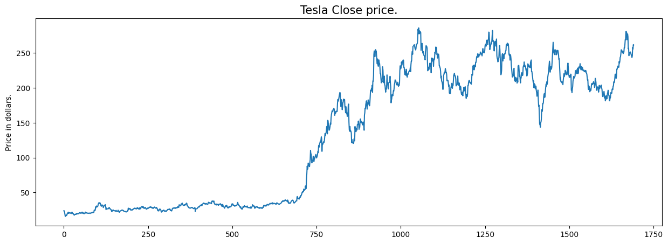
OUTPUT

Slide 9
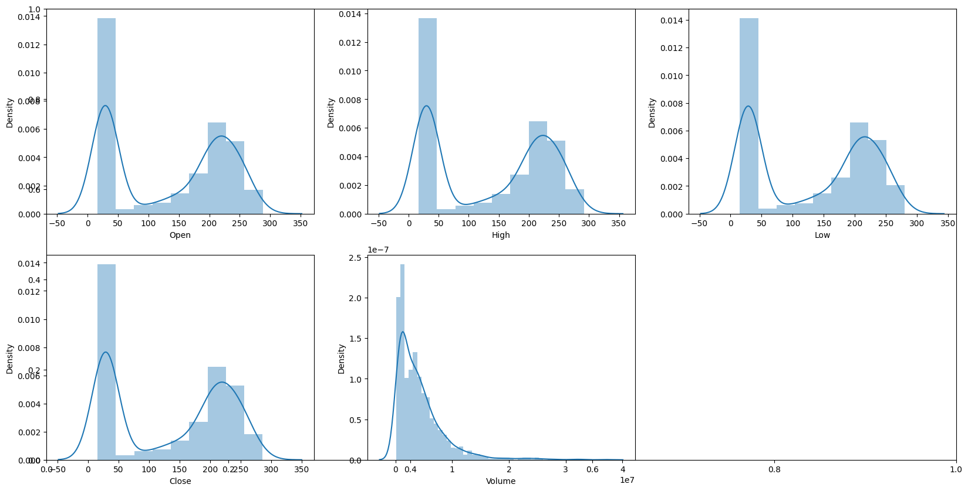
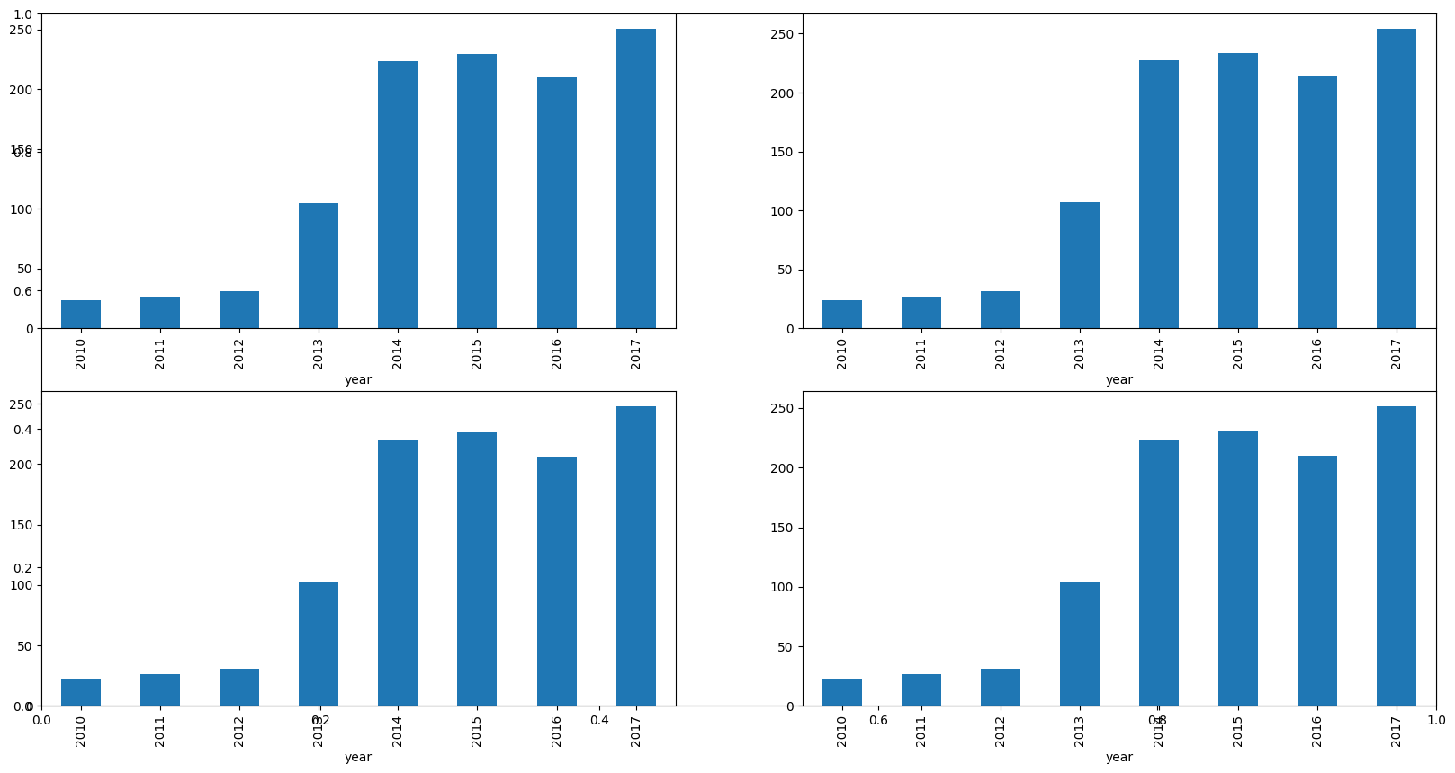
OUTPUT
Distribution Plot
Bar Graph

Slide 10
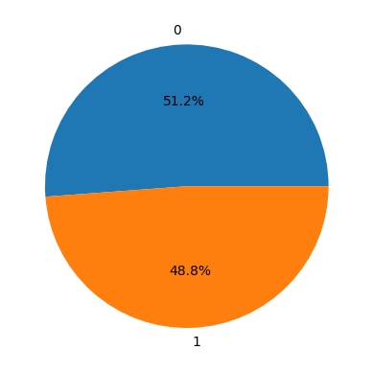
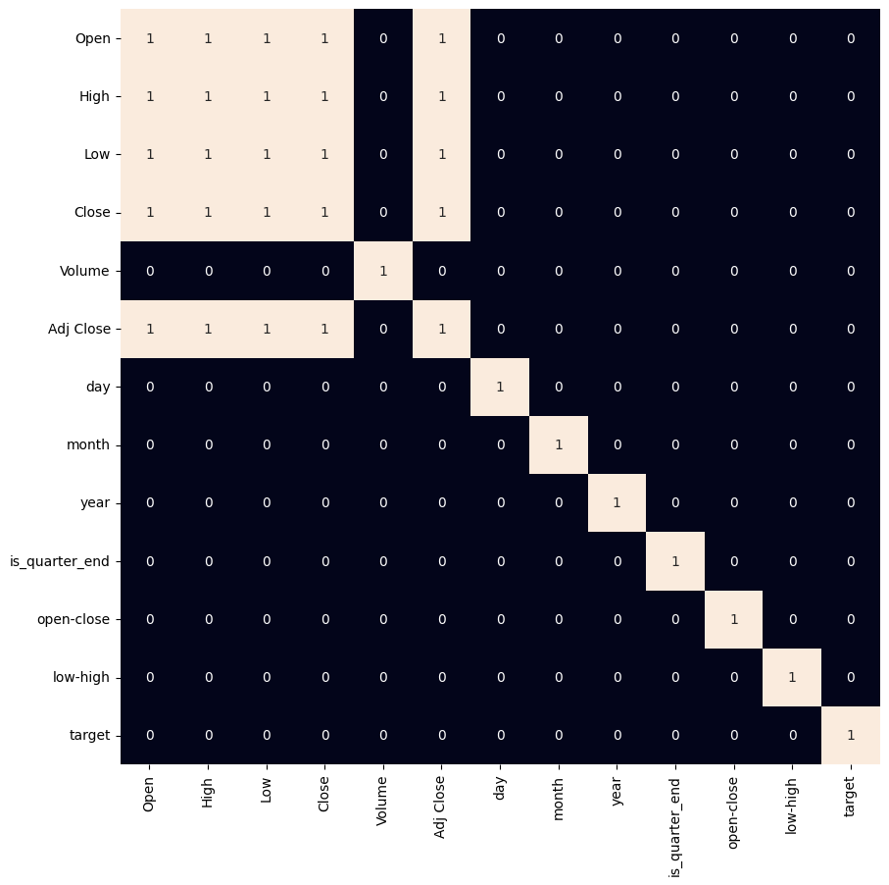
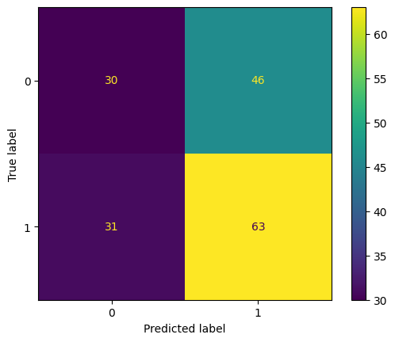
OUTPUT
Training Set
Heat Map
Confusion Matrix

Slide 11
Conclusion
Summarize the findings and discuss the effectiveness of the proposed stock price prediction model. Highlight any challenges encountered during the implementation, such as handling high volatility, data noise, or overfitting.
Mention potential improvements like incorporating sentiment analysis or real-time news feeds.
Emphasize the importance of accurate stock price forecasting in supporting smarter investment decisions, minimizing financial risk, and enhancing portfolio management strategies.

Slide 12
Future scope
Discuss potential enhancements and expansions for the stock price prediction system.
This could include integrating alternative data sources such as financial news sentiment, social media trends, or macroeconomic indicators to improve forecasting accuracy.
Future improvements may also involve optimizing the model with advanced techniques like transformer-based architectures or ensemble methods.
Additionally, deploying the system on scalable cloud platforms or incorporating real-time data pipelines can make the model suitable for live trading environments.

Slide 13
References
Geeks for Geeks. (2021). Stock Price Prediction using Machine Learning in Python.
Link: https://www.geeksforgeeks.org/machine-learning-stock-price-prediction-using-machine-learning-in-python
Brownlee, J. (2020). Introduction to Time Series Forecasting with Python. Machine Learning Mastery.
Chollet, F. (2018). Deep Learning with Python. Manning Publications.
Scikit-learn Developers. (2023). Scikit-learn: Machine Learning in Python. Link: https://scikit-learn.org/stable/
TensorFlow Developers. (2023). Time Series Forecasting. Link: https://www.tensorflow.org/tutorials/structured_data/time_series

Slide 14
THANK YOU

